Slide 1

Breast Cancer Tumour Classification Using Machine Learning Models
CMPE 257 Fall 2020
Instructor: Dr. Mahima Agumbe Suresh
Computer Engineering
San Jose State University
Akash Aggarwal Amitha Sreshta Papetla
Srijoni Chakraborthy Sowmya Mruthyunjaya

Slide 2

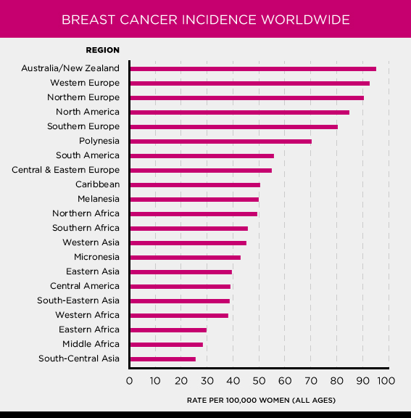

Introduction
Breast cancer is the most common cancer in women worldwide with a high mortality rate.
Cells in breast tissue change and divide uncontrollably, typically resulting in a tumor.
Benign
Malignant

Slide 3

Objective
Given breast cancer results from breast fine needle aspiration (FNA) test, build a machine learning model that can classify a breast cancer tumor using two training classification
Malignant
Benign

Slide 4
Methodology
Data Visualization and pre-processing
Model Training and Testing: The Machine Learning models; That we have used to train the data are:
Logistic Regression
SVM
Decision Trees
KNN
Random Forest Classification
Results and Observations
Logistic Regression
EDA
Data Preprocessing
SVM
Breast Cancer Wisconsin Diagnostic dataset
Model selection criteria
Random Forest
Decision Tree
KNN

Slide 5
Data Set
The breast cancer data set that is used in this project is from the UCI Machine Learning Repository.
It was created by Dr.William H. Wolberg, physician at the University of Wisconsin Hospital at Madison.
569 instances with class distribution of 357 benign and 212 malignant.
Each sample consists of ID number, diagnosis (B = benign, M = malignant), and 30 features.
Features have been computed from a digitized image of a fine needle aspirate (FNA) of a breast mass.

Slide 6
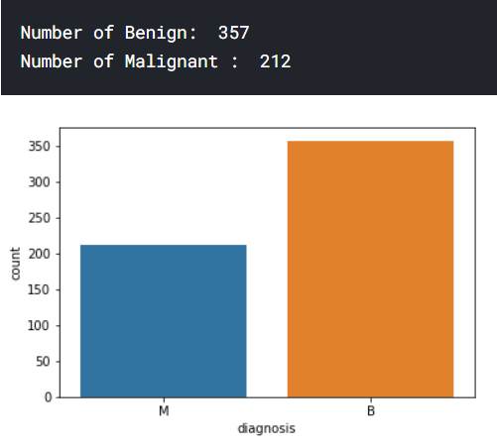
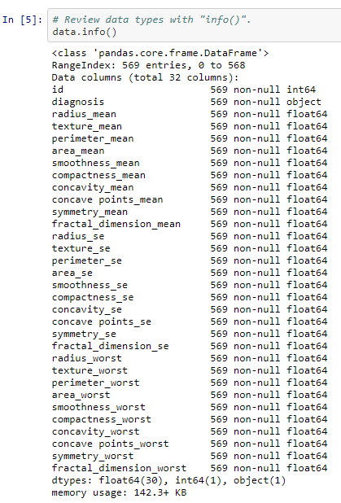
Exploratory Data Analysis and Data Visualization
Exploratory Data Analysis refers to the critical process of performing initial investigations on data so as to discover patterns, to spot anomalies, to test hypothesis and to check assumptions with the help of summary statistics and graphical representations.

Slide 7
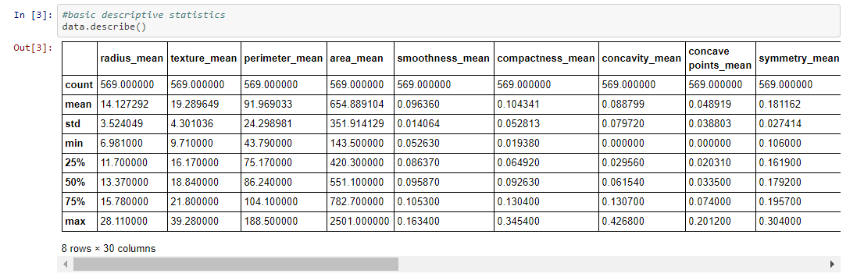
Exploratory Data Analysis and Data Visualization

Slide 8
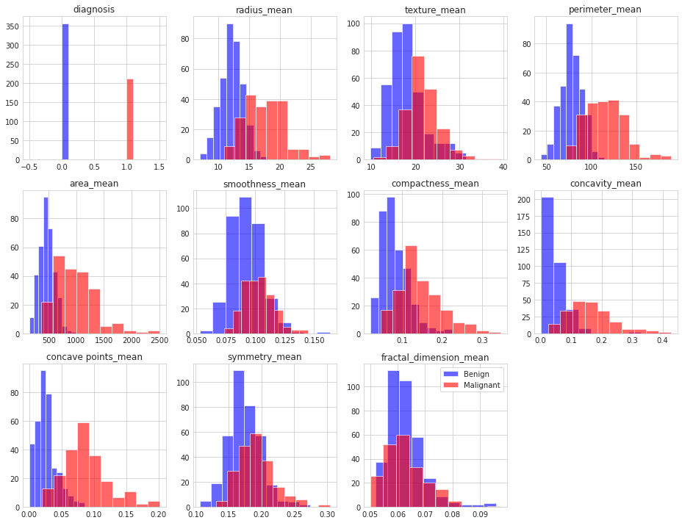
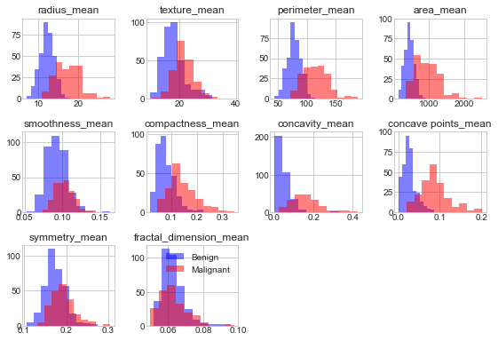
Exploratory Data Analysis and Data Visualization

Slide 9
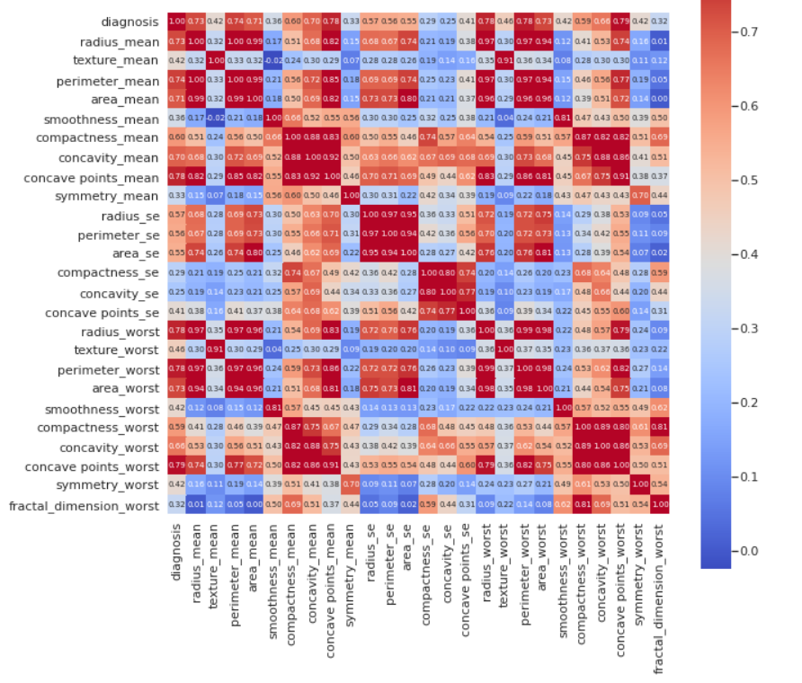
Correlation between the features

Slide 10
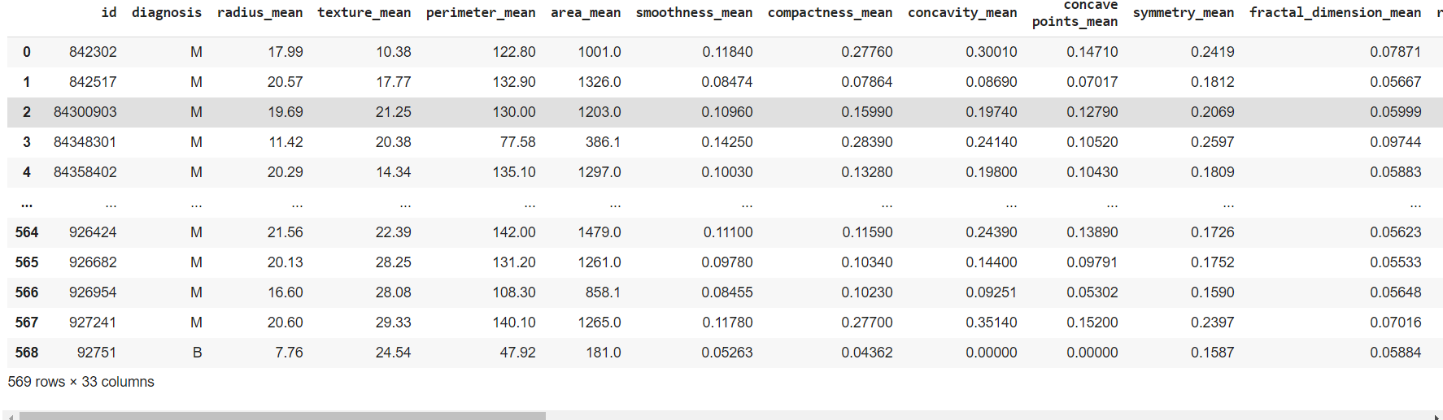
Data preprocessing
Transform the class labels from their original string representation (M and B) into integers
Check data for missing values
Drop unnecessary columns - ID, Unnamed ‘NaN’
Feature selection - drop features that do not add any value in prediction
Splitting the data set into 80% training and 20% test data
Feature standardisation using standard scaler - bring all features to same level of magnitudes
K fold Cross validation

Slide 11
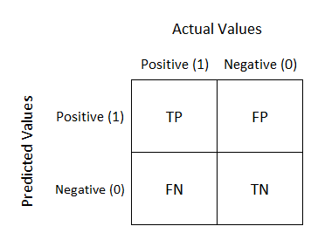


Evaluation metrics
Confusion Matrix:A confusion matrix is used to judge the performance of a classifier on the test dataset for which we already know the actual values. Confusion matrix is also termed as Error matrix.

Slide 12



Evaluation metrics
F1-score: F-score helps to find the metrics of Recall and Precision in the same interval. Harmonic Mean is used instead of Arithmetic Mean.
measure of all actual positives out of all predicted positive values
measure of positive values that are predicted correctly out of all actual positive values

Slide 13

Model Selection
For this project, we are have chosen 5 Models for training and testing
Parametric Model: Logistic Regression
Non Parametric Model: K Nearest Neighbors
Non Linear Model: Random Forest Classifier
Non Parametric Model: Support Vector Machines
Non Linear Model: Decision Tree Classifier

Slide 14
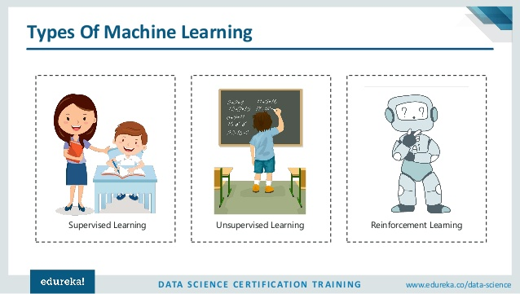
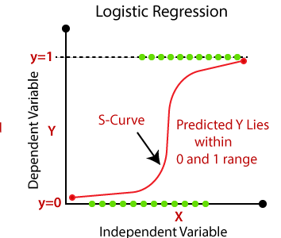
Logistic Regression
Regression is part of
Given a set of independent variables, Logistic Regression is a method to predict dependent variable such that it is categorical.
In our data, we predict based on features whether Tumor is Benign or Malignant.

Slide 15
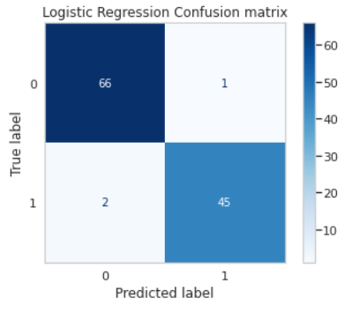
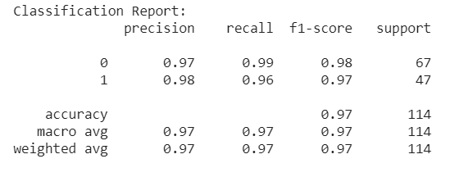
Logistic Regression
Train Accuracy | Test Accuracy
0.982418 | 0.97368421

Slide 16
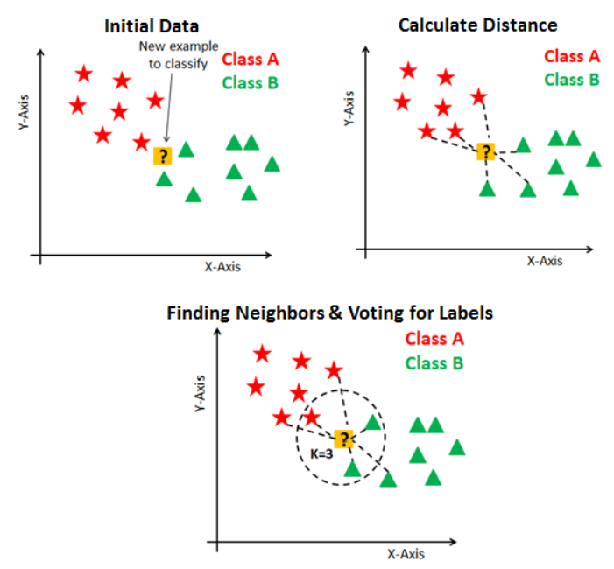
KNN
K-Nearest Neighbor is a distance based recognition algorithm.
KNN algorithm uses ‘feature similarity’
to predict the values of new data points
K is an integer value specified by the user.
For our project, we will use Euclidean Distance.

Slide 17
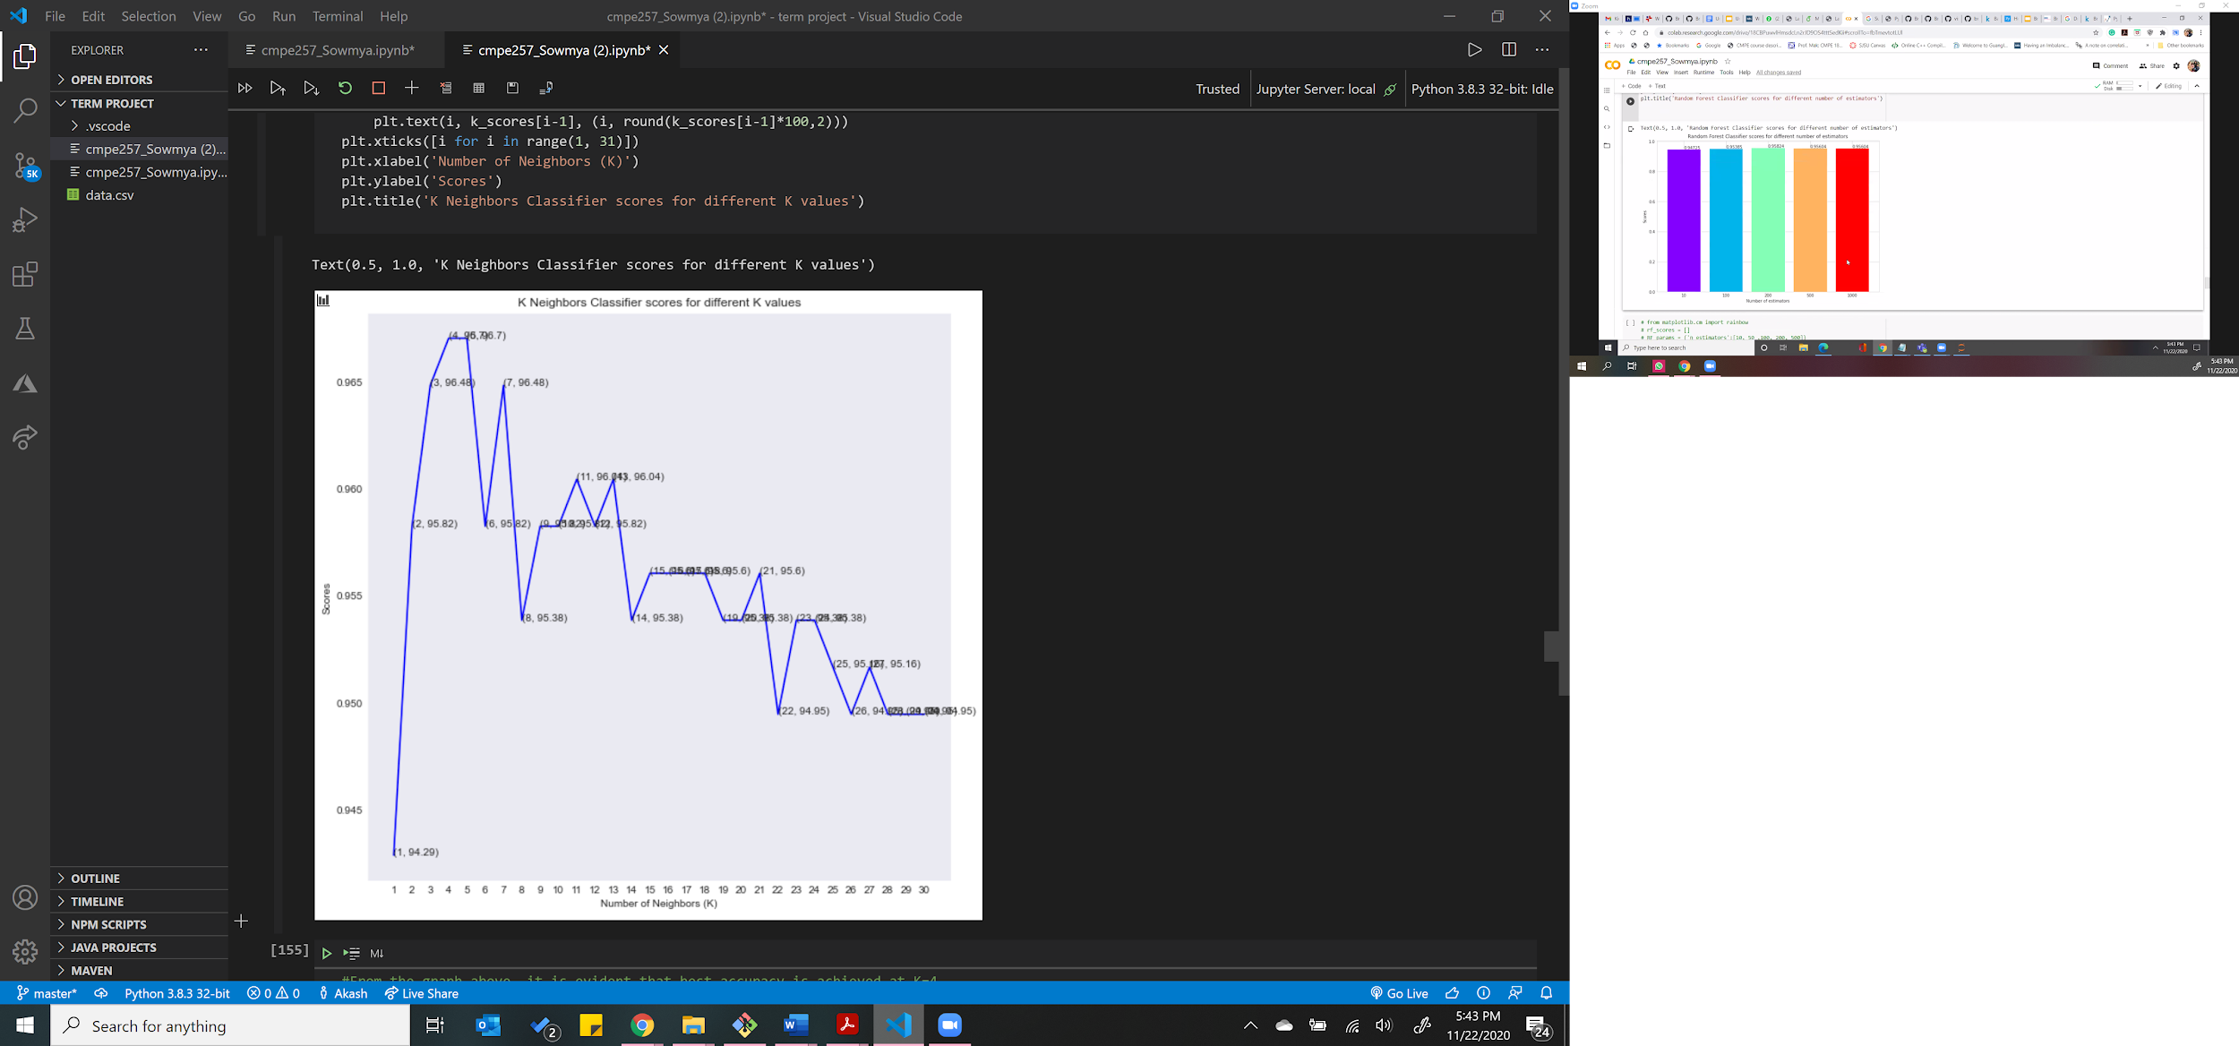
KNN
1. Plotting Curve between accuracy and
number of Neighbors, K = 4 gives the best
accuracy.
2. We test our data using 4 Neighbors.
Train Accuracy | Test Accuracy
0.969231 | 0.964912

Slide 18
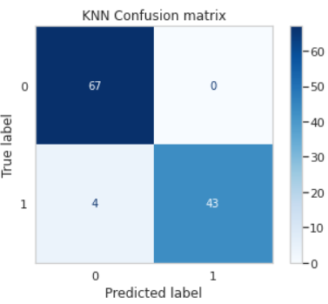
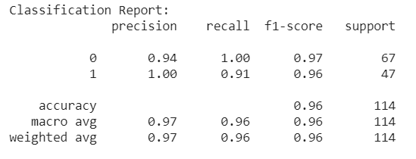
Accuracy and Classification report of KNN model

Slide 19
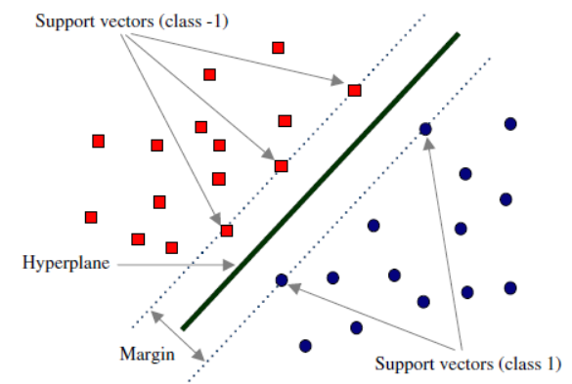
Support Vector Machines (SVM)
SVM is a supervised machine learning model.
SVMs transform the input data in a way that produces the widest plane, or support vector, of separation between 2 classes.
SVMs choose an optimal hyperplane for linearly separable patterns
For patterns that are not linearly separable, the original data is transformed to map into new space- the Kernel function

Slide 20
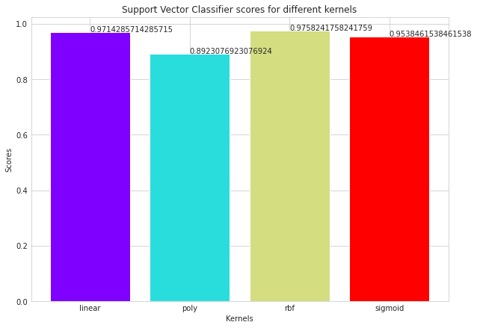
SVM

Slide 21
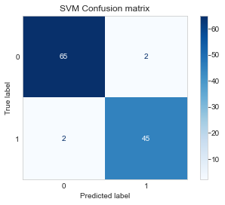
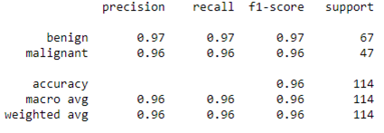
Confusion Matrix and Classification Report : SVM Model
Train | Test
97.58 | 96.49

Slide 22
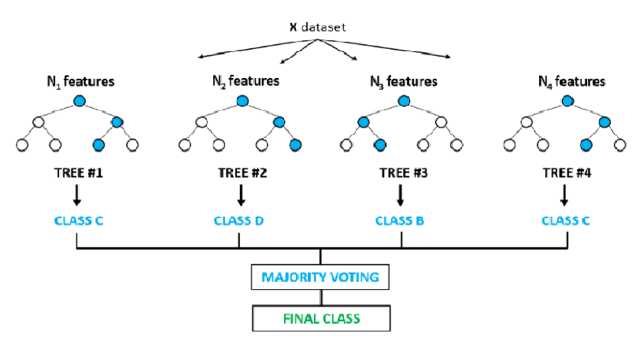
Random Forest Classifier
Random forest classifier is an ensemble algorithm.
It creates a set of decision trees from a randomly selected subset of the training set.
To select the final class of the test object, it aggregates votes from different decision trees.

Slide 23
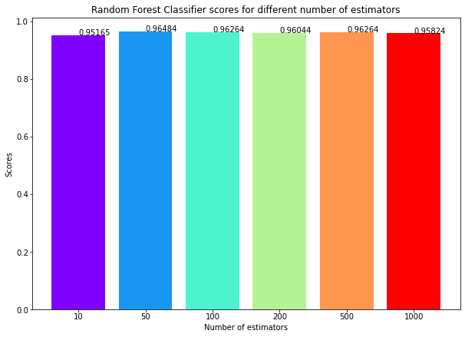
Random Forest Classifier

Slide 24
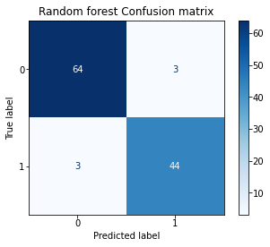
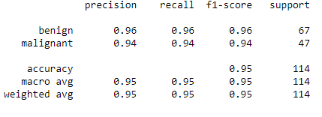
Confusion Matrix and Classification Report : RFC Model
Train | Test
96.48 | 94.74

Slide 25
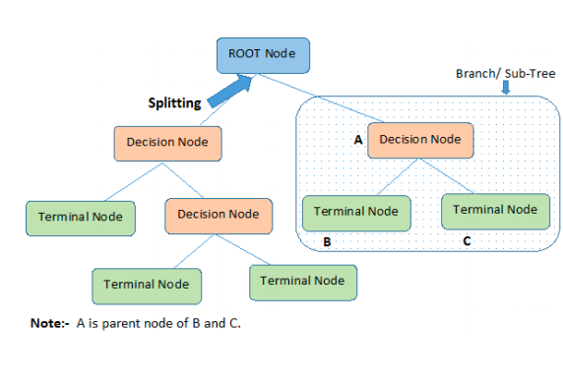
Decision Tree Classifier
Decision tree analysis is a predictive modelling tool, which can be used for both classification and regression tasks.
The two main entities of a tree are decision nodes, where the data is split and leaves are the ones where we get outcome.
Each node in the tree acts as a test case for some attribute, and each edge descending from that node corresponds to one of the possible answers to the test case.

Slide 26
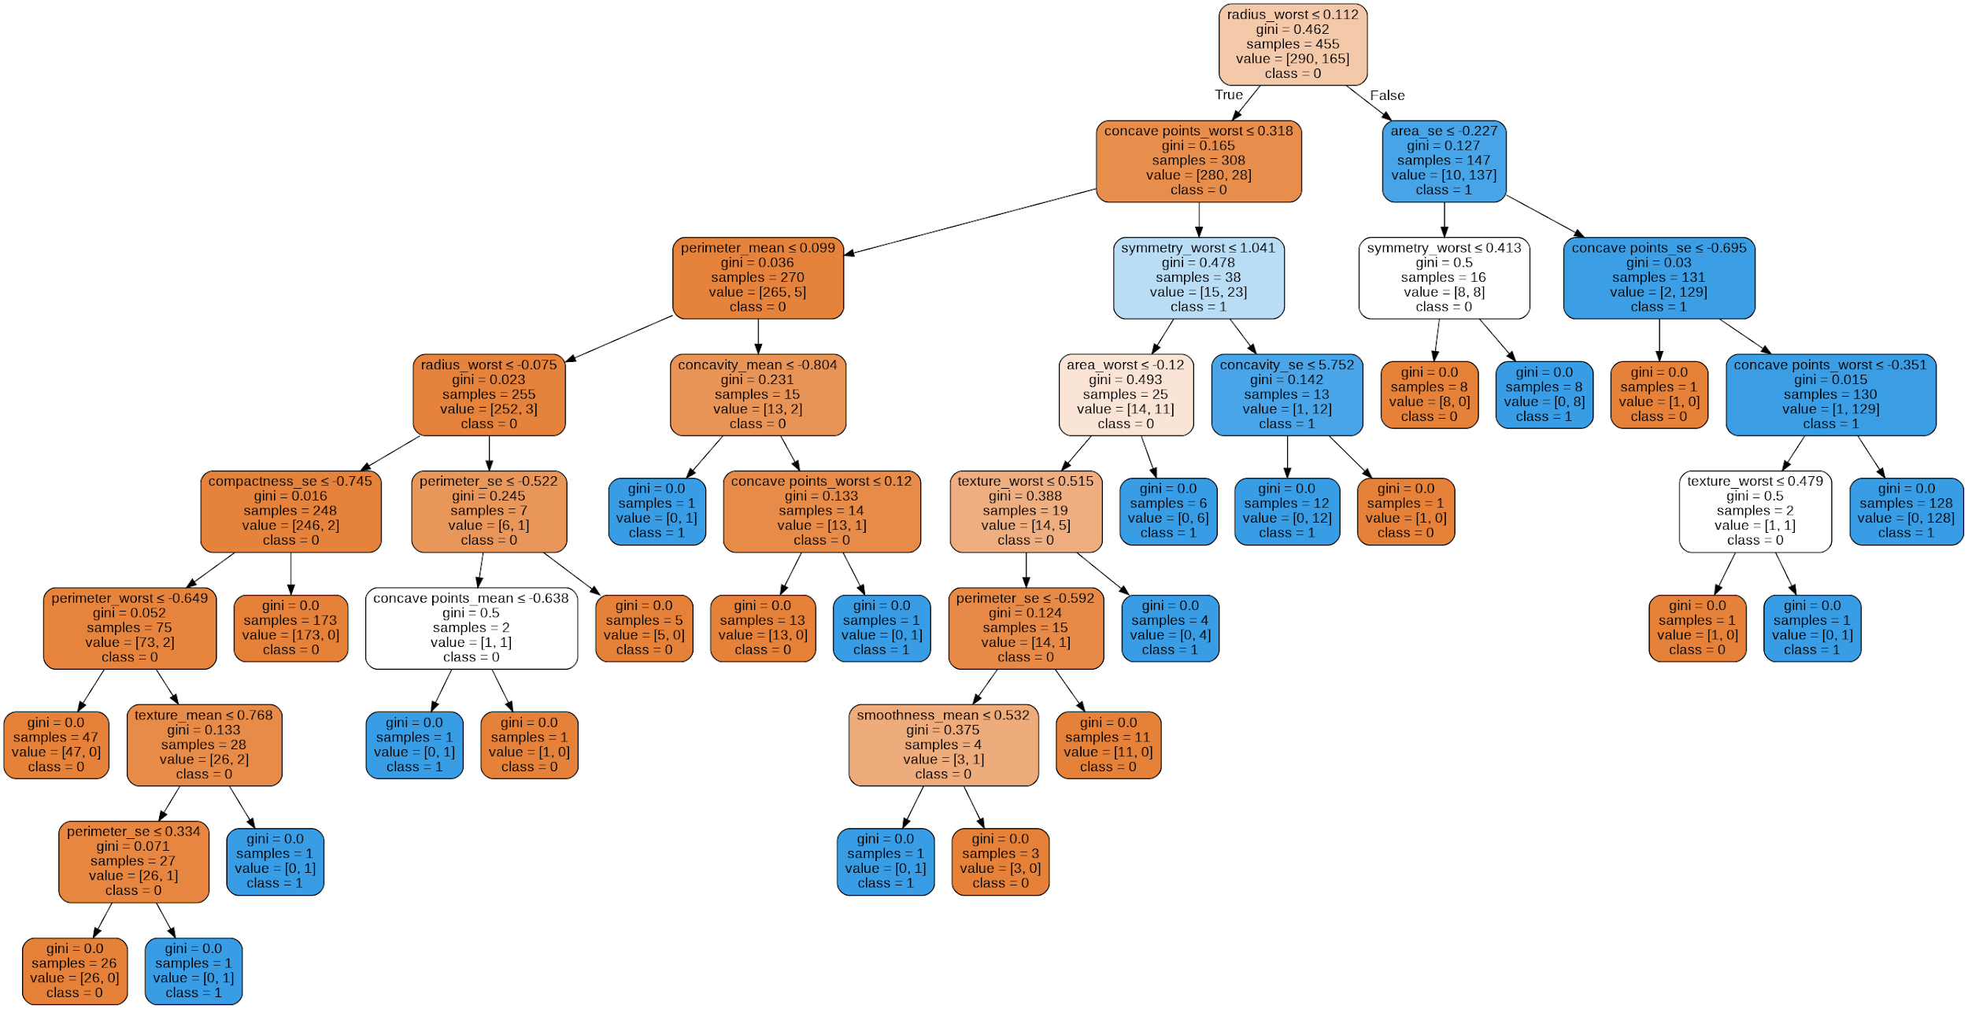

Slide 27
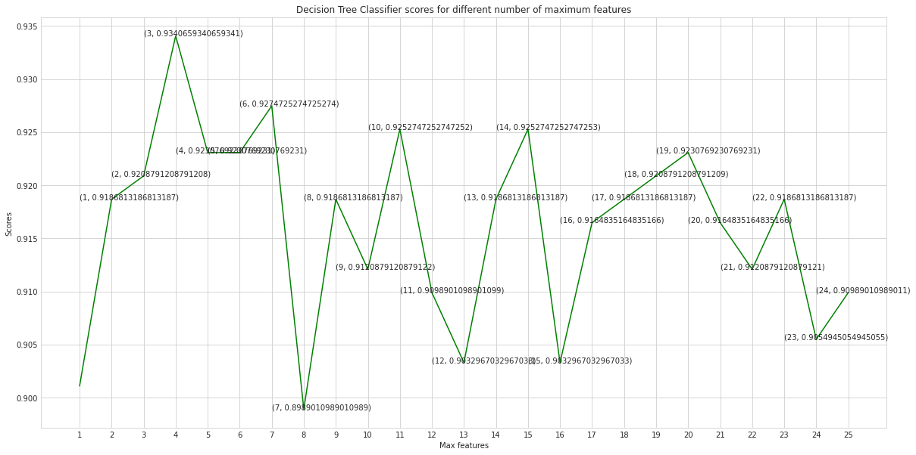
Scores for different number of maximum features

Slide 28
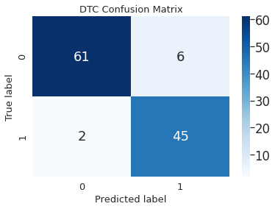
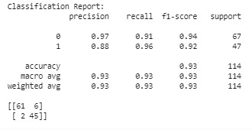
Confusion Matrix and Classification Report : DTC model
Train | Test
93.06 | 92.98

Slide 29
Results
Model | Train | Test
SVM | 97.58 | 96.49
Random Forest | 96.48 | 94.74
Logistic Regression | 98.24 | 97.36
Decision tree | 94.06 | 92.98
KNN | 96.92 | 96.49

Slide 30

Conclusion
Breast cancer diagnosis can be predicted with roughly 95% accuracy.
Machine learning algorithms that performed the best include linear models: logistic regression followed by SVM and Random forest.
A decision support system for predicting breast cancer helps and assists physicians in making optimum, accurate and timely decision to improve the quality of life of patients by predicting breast cancer at early stage of development and reduce the overall cost of treatment.

Slide 31

Thank You!
Any Questions?
“There can be life after breast cancer. The prerequisite is early detection.”
– Ann Jillian

